Slide 1
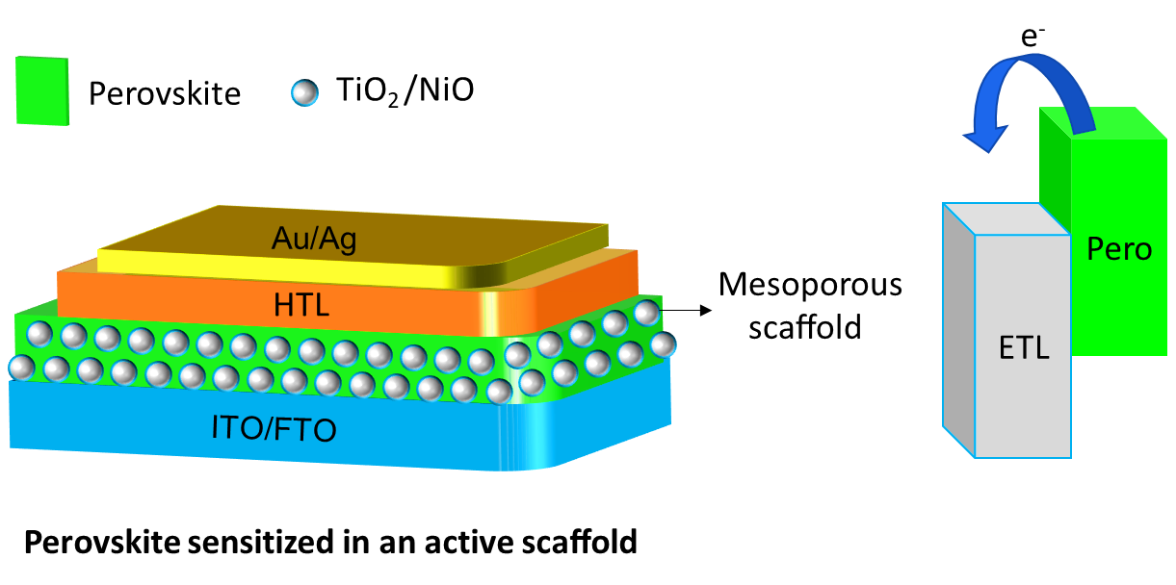
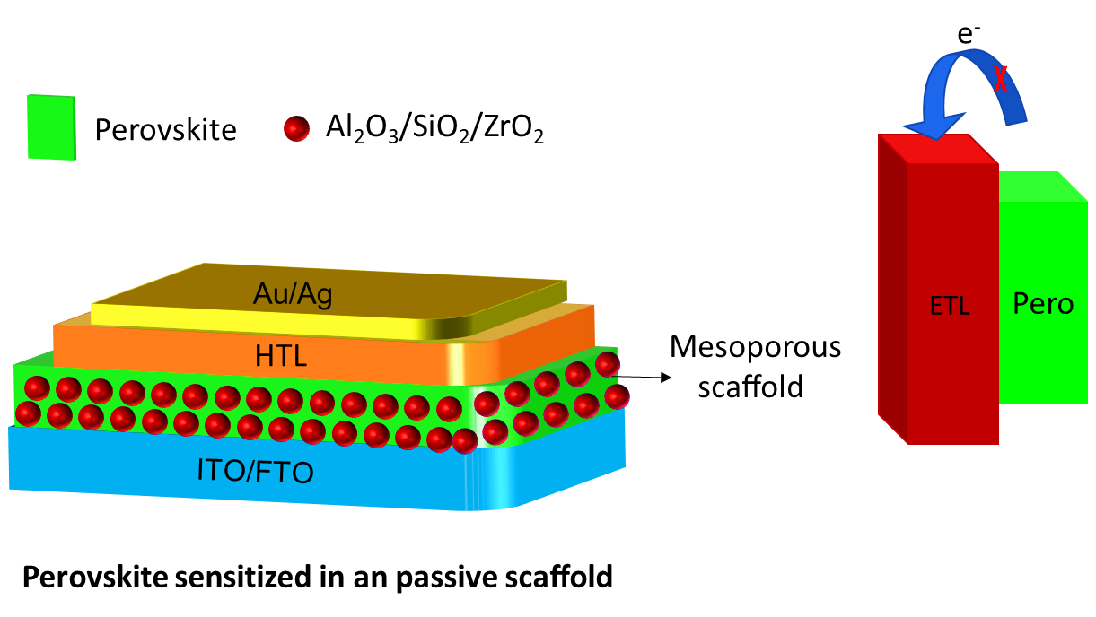
Figure 1. Mesoporous scaffolds for templet based NC’s

Slide 2
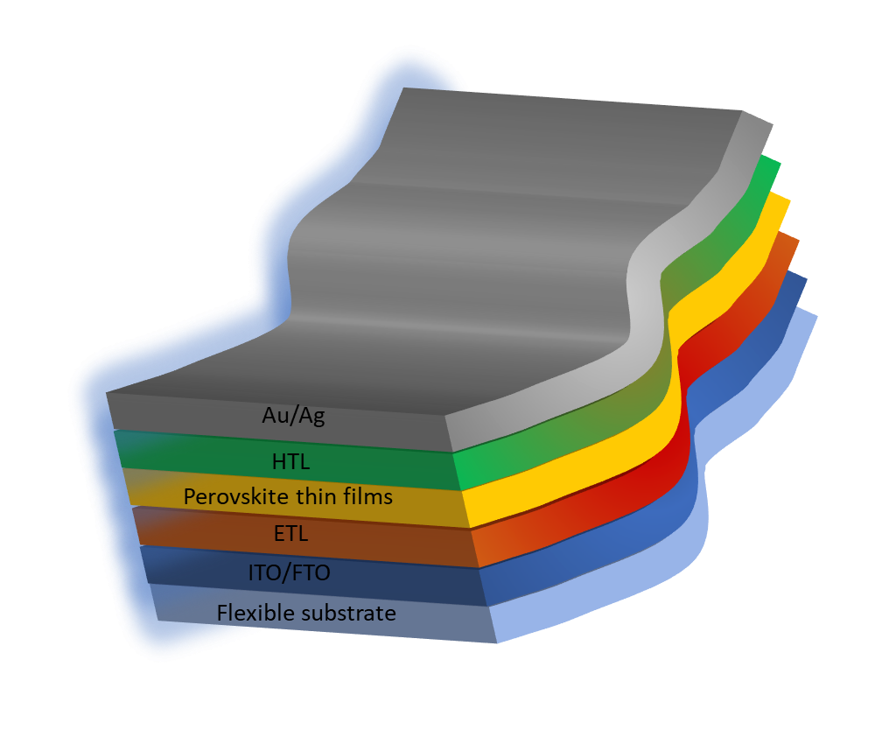

Flexible solar cell devices using QDs

Slide 3
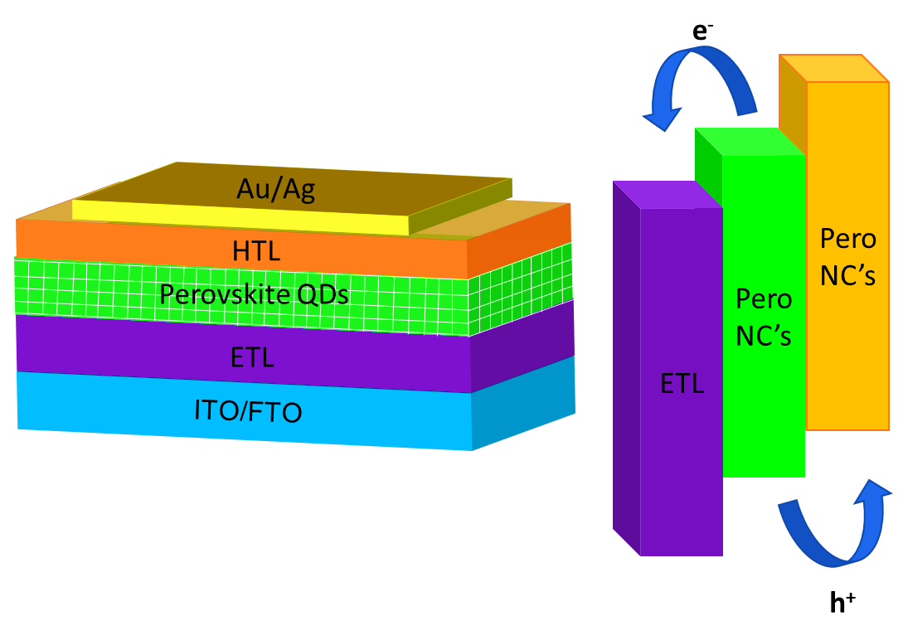
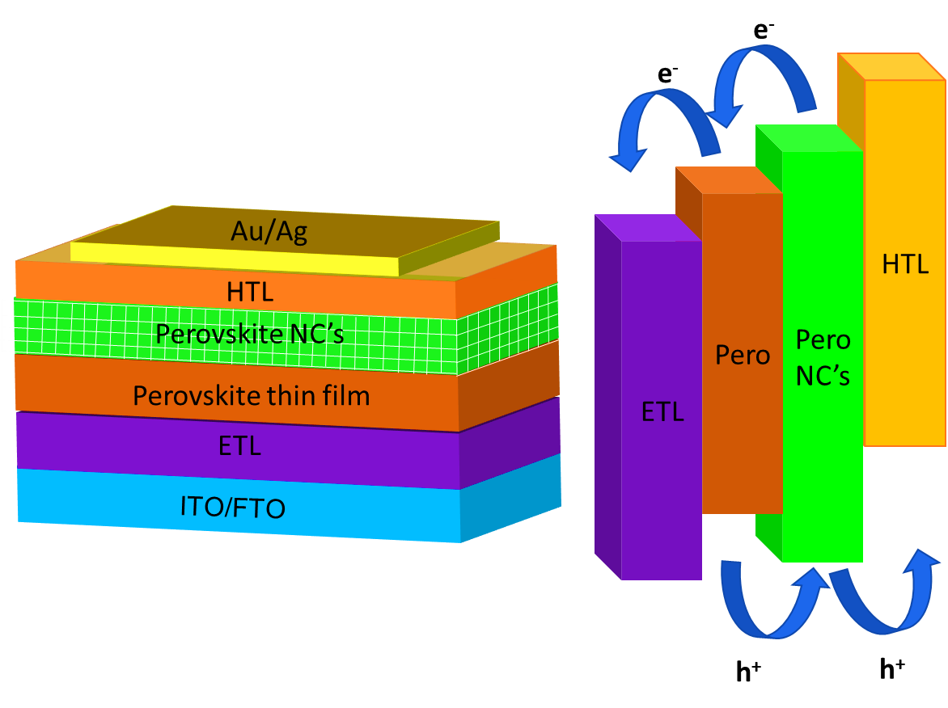
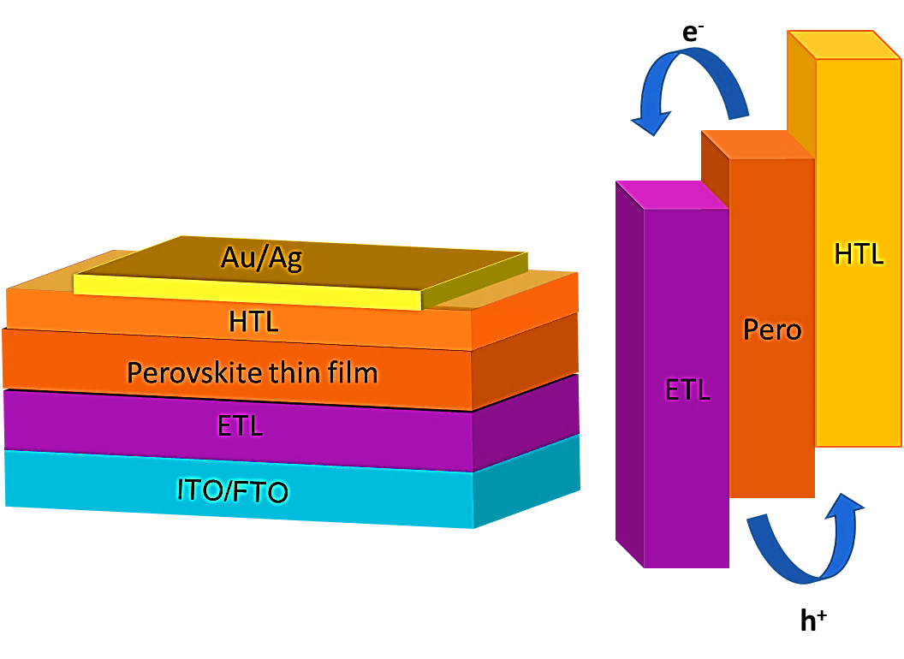
Solar device with perovskite thin layer as active layer.
Solar device with perovskite NC’s as active layer.
Hybrid perovskite heterojunction solar cell

Slide 4
e⁻
e⁻
HTL
e⁻
Pero B NC’s
Pero
A NC’s
Perovskite A NC’s
Perovskite B NC’s
Pero
ETL
Au/Ag
HTL
Au/Ag
Perovskite NC’s
Perovskite thin film
ETL
ITO/FTO
h⁺
h⁺
h⁺
Better matching energy levels between perovskites and HTL by Mixed pero NC’s

Slide 5
e⁻
e⁻
HTL
Pero NC’s
Pero
Au/Ag
ETL
HTL
Perovskite NC’s
Perovskite thin film
NiO/ CuSCN/Cu:NiO
ITO/FTO
h⁺
h⁺
Seeking cheap inorganic hole transport materials instead of expensive organic HTL

